Slide 1
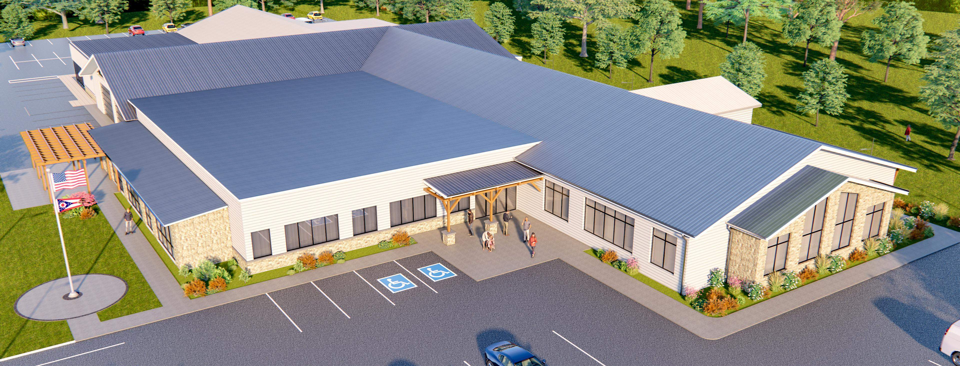

Carroll County Veterans Memorial Community Wellness Center

Slide 2
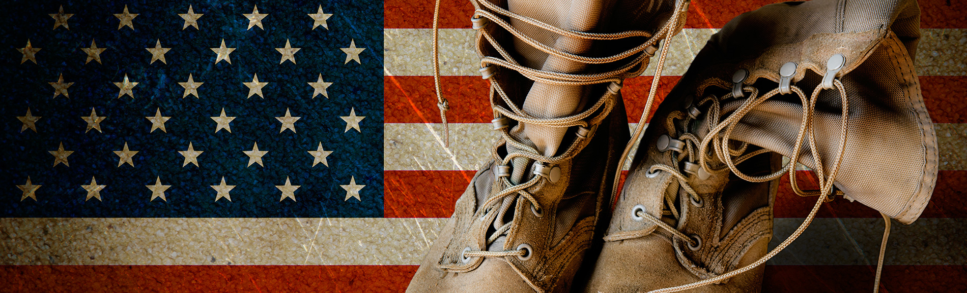
Project Objectives:
Why? How?
The Center is a holistic approach to supporting all aspects of health & wellness for military veterans, first-responders, and their families in the region.
delivers quality-of-life services and programs to support health, wellness, & well-being across generations:
    social services, dental care, and mental/behavioral health services, mental & spiritual wellness, physical & occupational therapy, and chiropractic services
renovates, expands, and re-purposes the shuttered Veterans Memorial facility
modernizes the adjacent Veterans Memorial Park, located next to the Carroll County Veterans’ facility

Slide 3
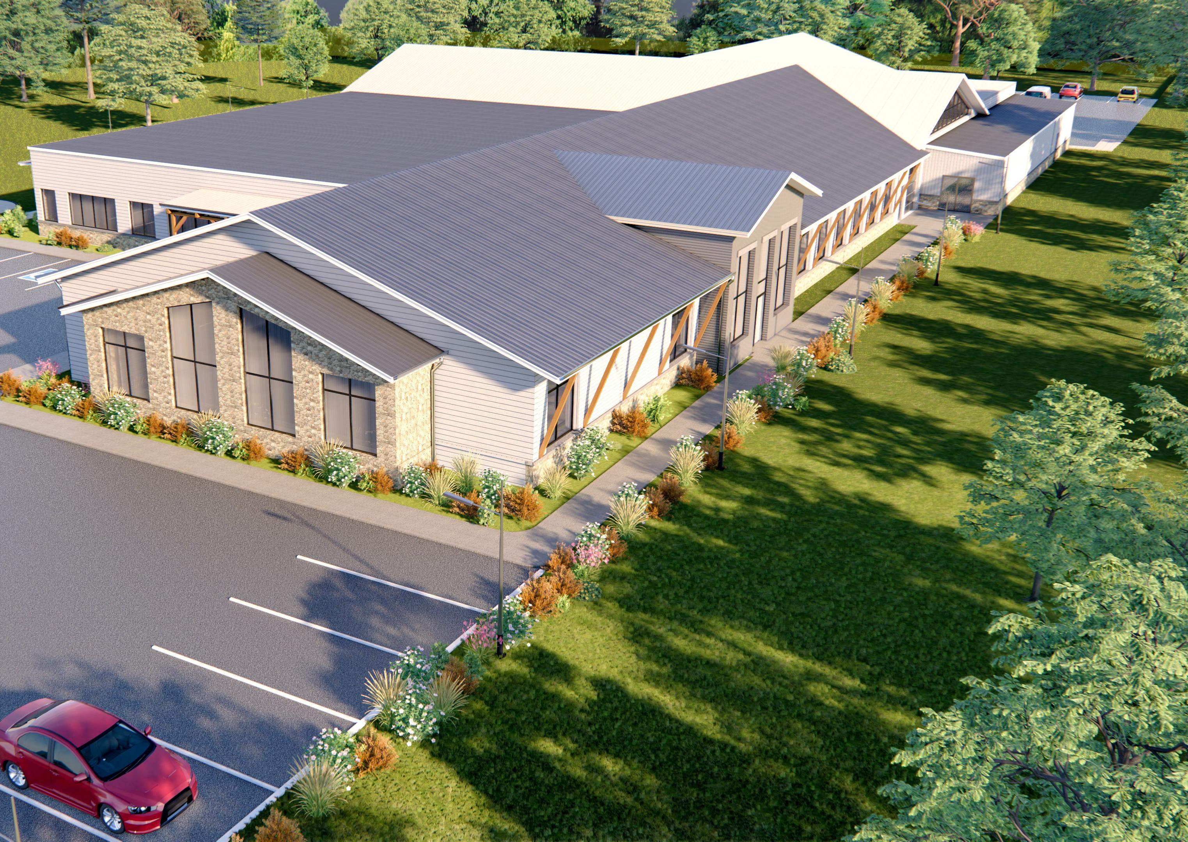
Service Area & Partnerships
Location: 2044 Brenner Rd., Carrollton, OH
Counties served: Carroll, Columbiana, Harrison, Jefferson, Stark, & Tuscarawas
Partners: Carroll County Commissioners, Carroll County Health Dept., Carrollton School District, Carroll County Veterans, Carroll County First Responders, SpringVale (a FQHC provider), Aultman Foundation

Slide 4
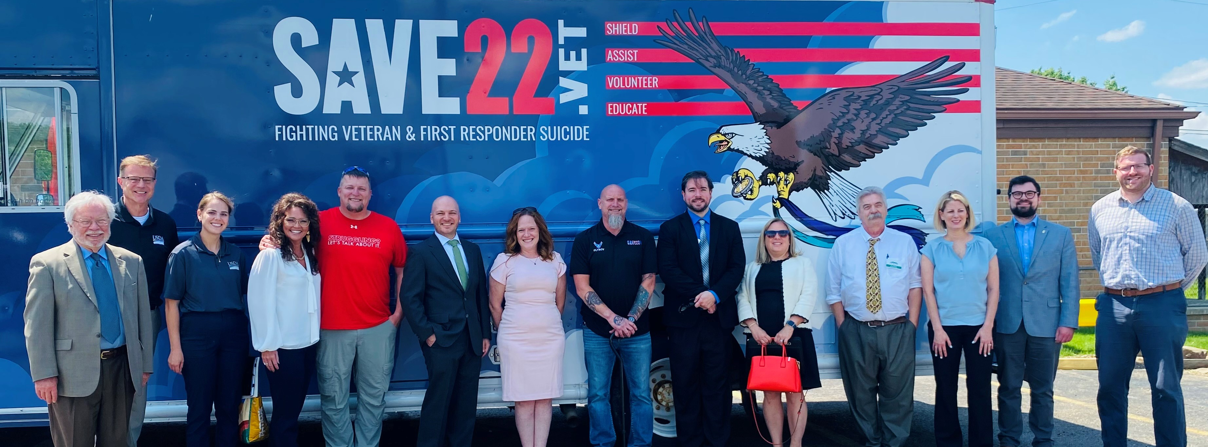
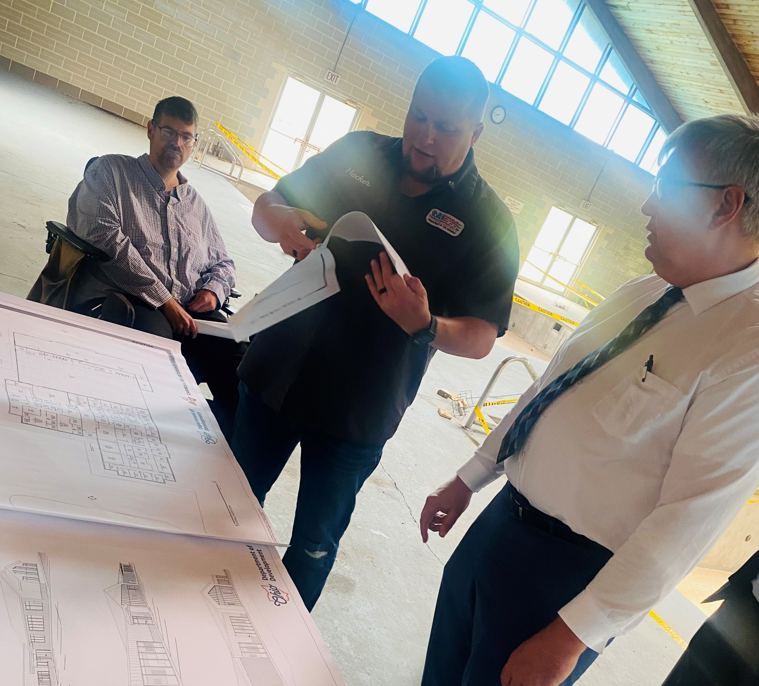
Relations & Gratitude
Carroll County Commissioners
  $40,000 Technical Assistance for program management
OMEGA: Ohio Mid-Eastern Governments Association
  Grant exploration; grant writing; planning assistance
Governor’s Office of Appalachia
  $100,100 award for roof repairs

Slide 5
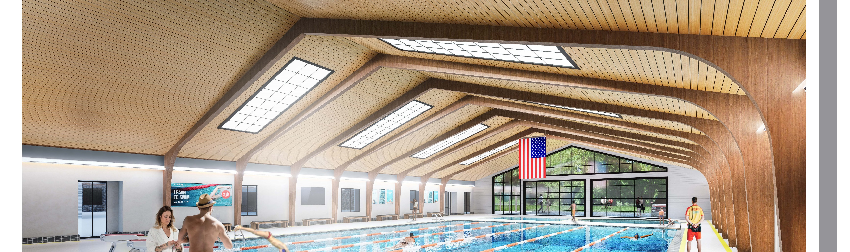
Owner & Project Lead
Who is SAVE22?
  501(c)3 private non-profit organization focused on fighting military veteran, active duty, and first responder suicide
Facility Ownership
  SAVE22 owns the facility and will provide counseling, aquatic therapy, and mental health resources for veterans, active military, and first responders and their families

Slide 6
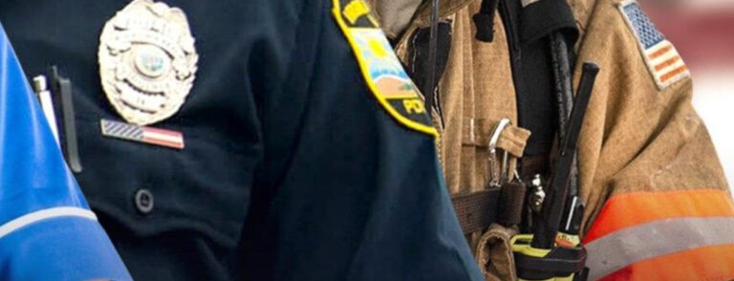

Project Impact
Outcomes to include:
1200-1400 people served annually
125+ students per event served through four or more school districts
30+ new jobs created in the county
centralized healthcare services in a “healthcare desert”
potential for Latch Key programs for after-school youth
mini-museum to honor Military Veterans and First Responders of Carroll County

Slide 7
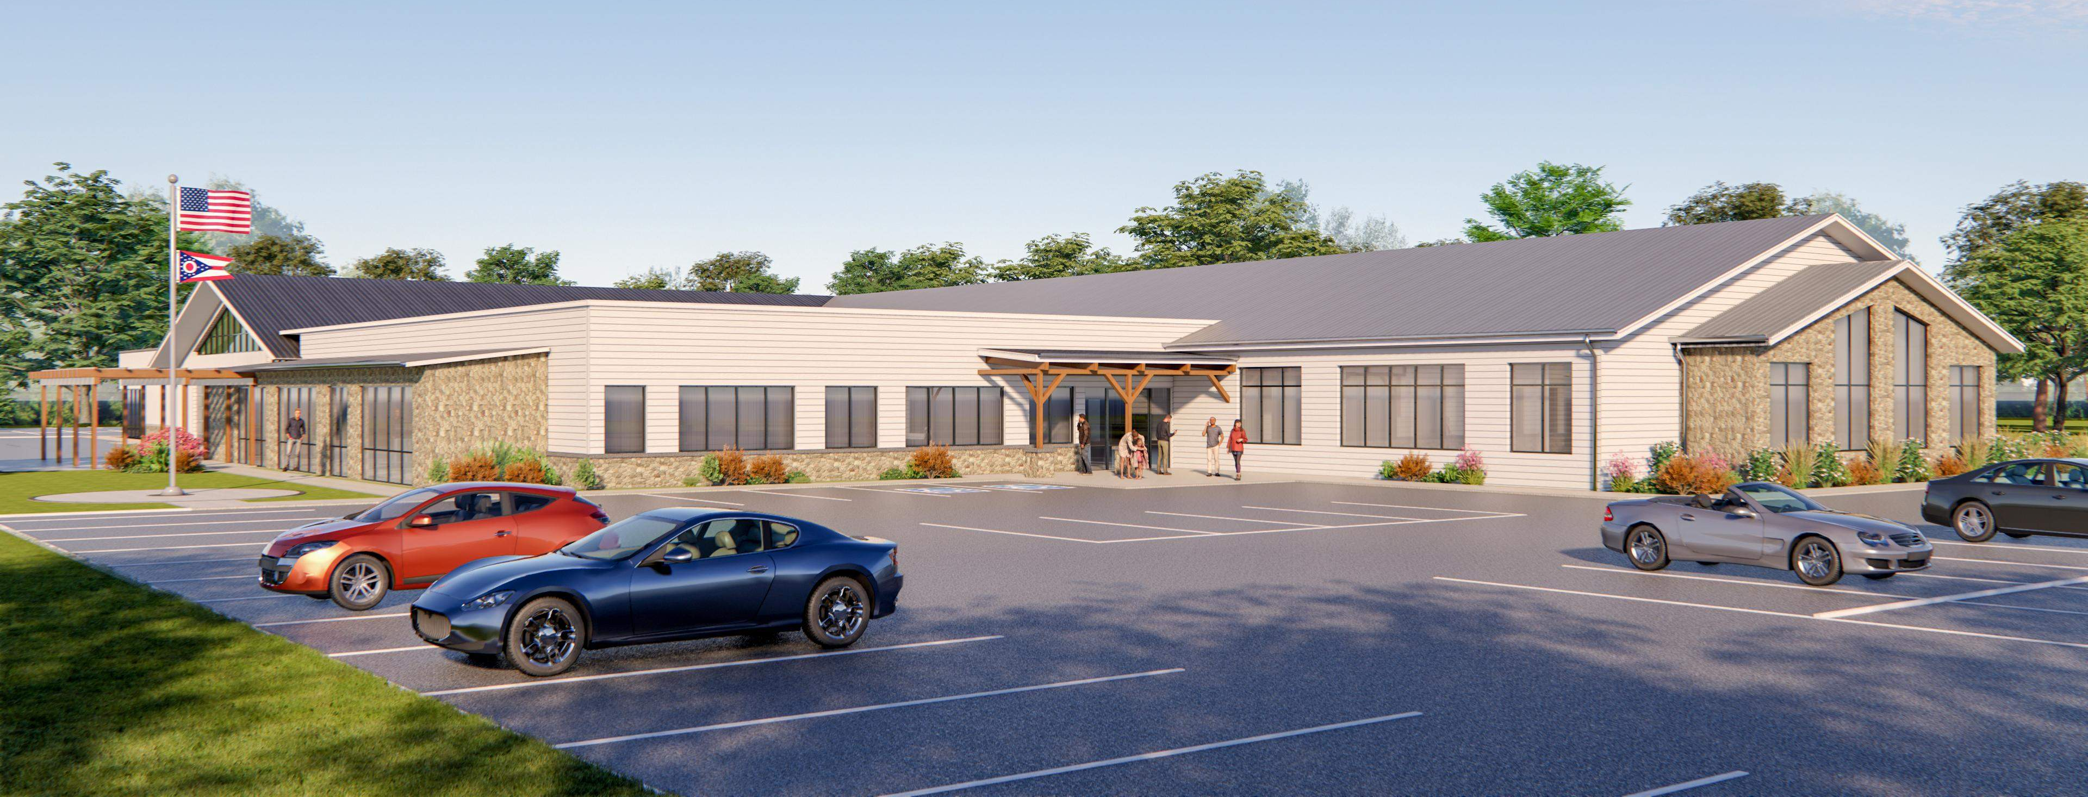
Budget & Request
Total Request Today = $6,000,000
Leverage / Commitments = $346,663
  United Way = $31,563
  Grahams (private) = $35,000 p/yr for five years = $175,000
  Governor’s Office of Appalachia = $100,100
  Carroll County Commissioners TA funding = $40,000
In-kind = thousands of volunteer hours (priceless!)
Total project cost = $10,000,000 (Phases I, II, III = $6,000,000)

Slide 8
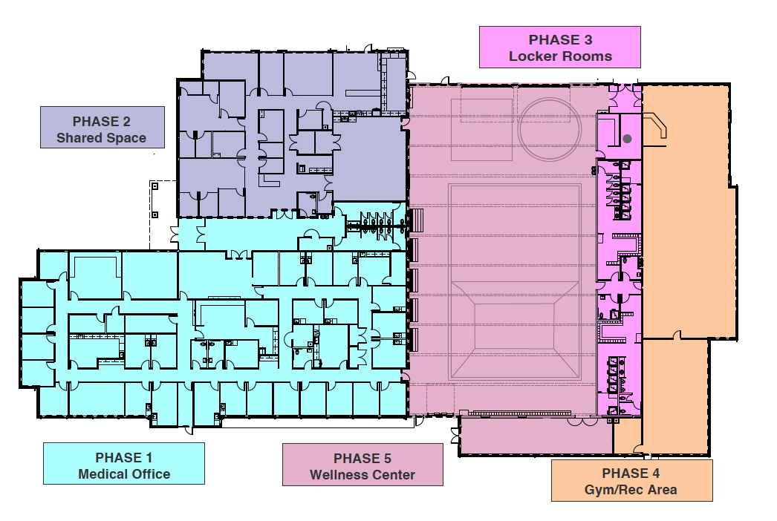
Phased funding approach
Phase 1 = $4m
Phase 2 = $1.5m
Phase 3 = $500k
Phase 4 = $2m
Phase 5 = $1.7m

Slide 9

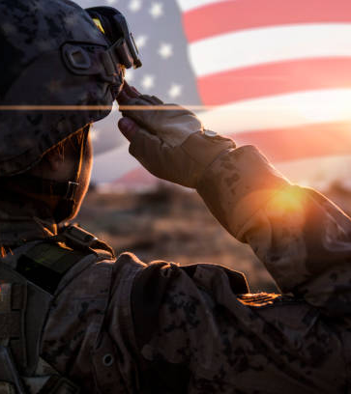

Thank you for your consideration & interest!

